Slide 1
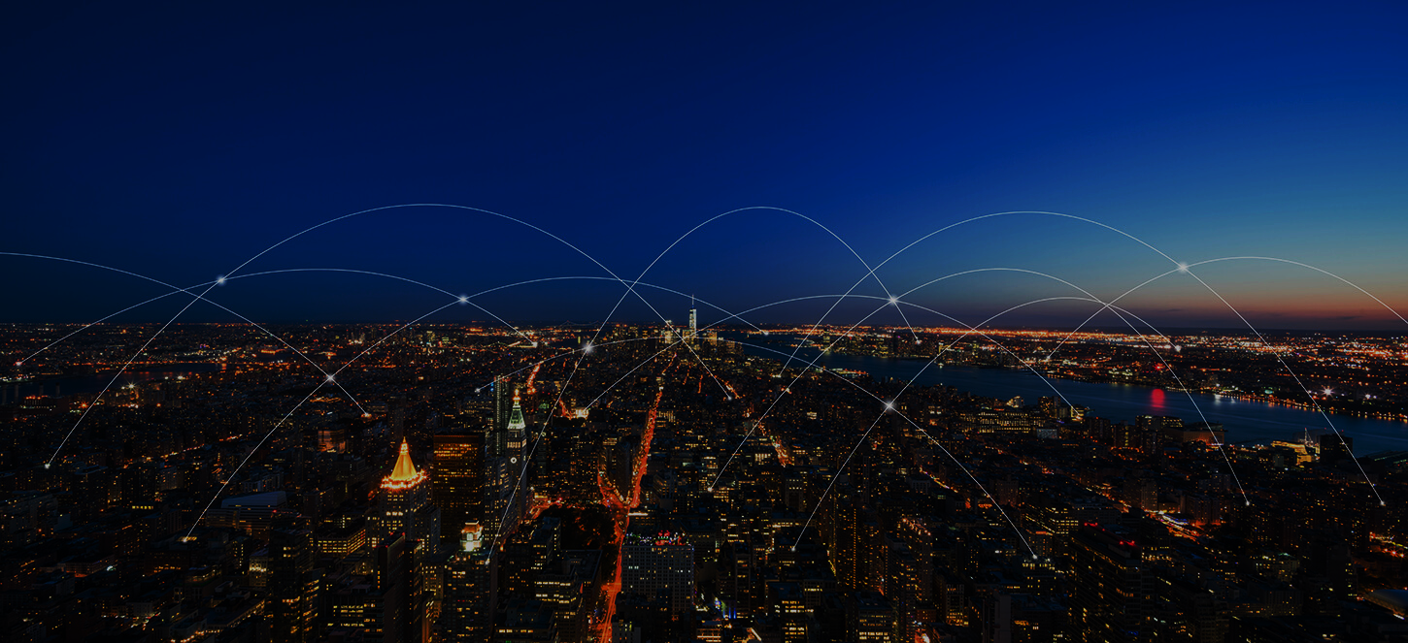
SMART CITY
By:
Harish H
Supriya M.K
Gourav P
Kiran
Sanjay
Assignment for Sabyasachi B
Guided By: Mohammad Tahir Mirji

Slide 2
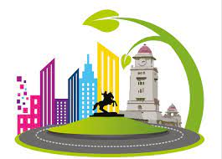
Introduction
Smart City:
A smart city is an urban area that utilizes technology and data-driven solutions to enhance the quality of life for its residents, improve the efficiency of services, and create a sustainable and inclusive environment.

Slide 3
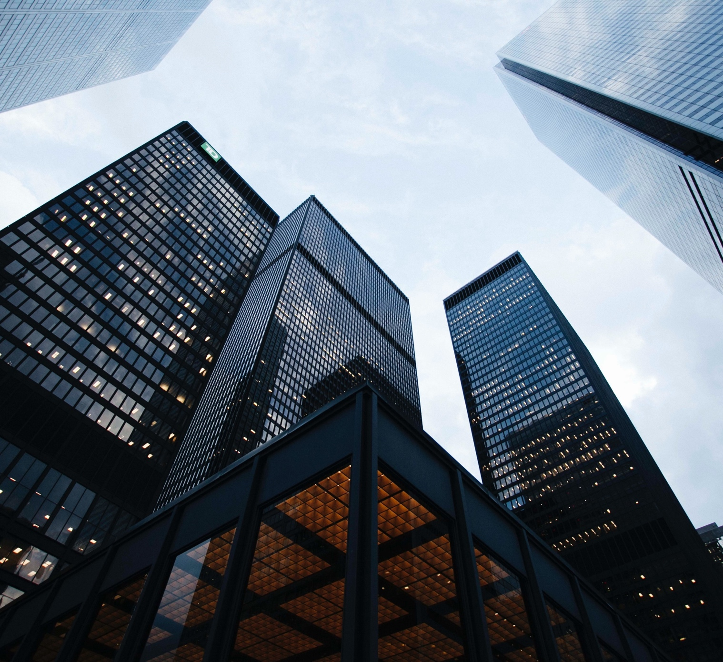
Importance of smart city
Smart cities are important because they bring many advantages to people living in urban areas. Here's a simple explanation of the importance of smart cities:
Better Living: Smart cities use technology to make our lives easier and more enjoyable. They provide improved services like healthcare, education, transportation, and safety, which enhance our quality of life.
Efficient Resource Use: Smart cities help us use resources like energy, water, and waste more efficiently. This saves money, reduces waste, and protects the environment for a sustainable future.

Slide 4
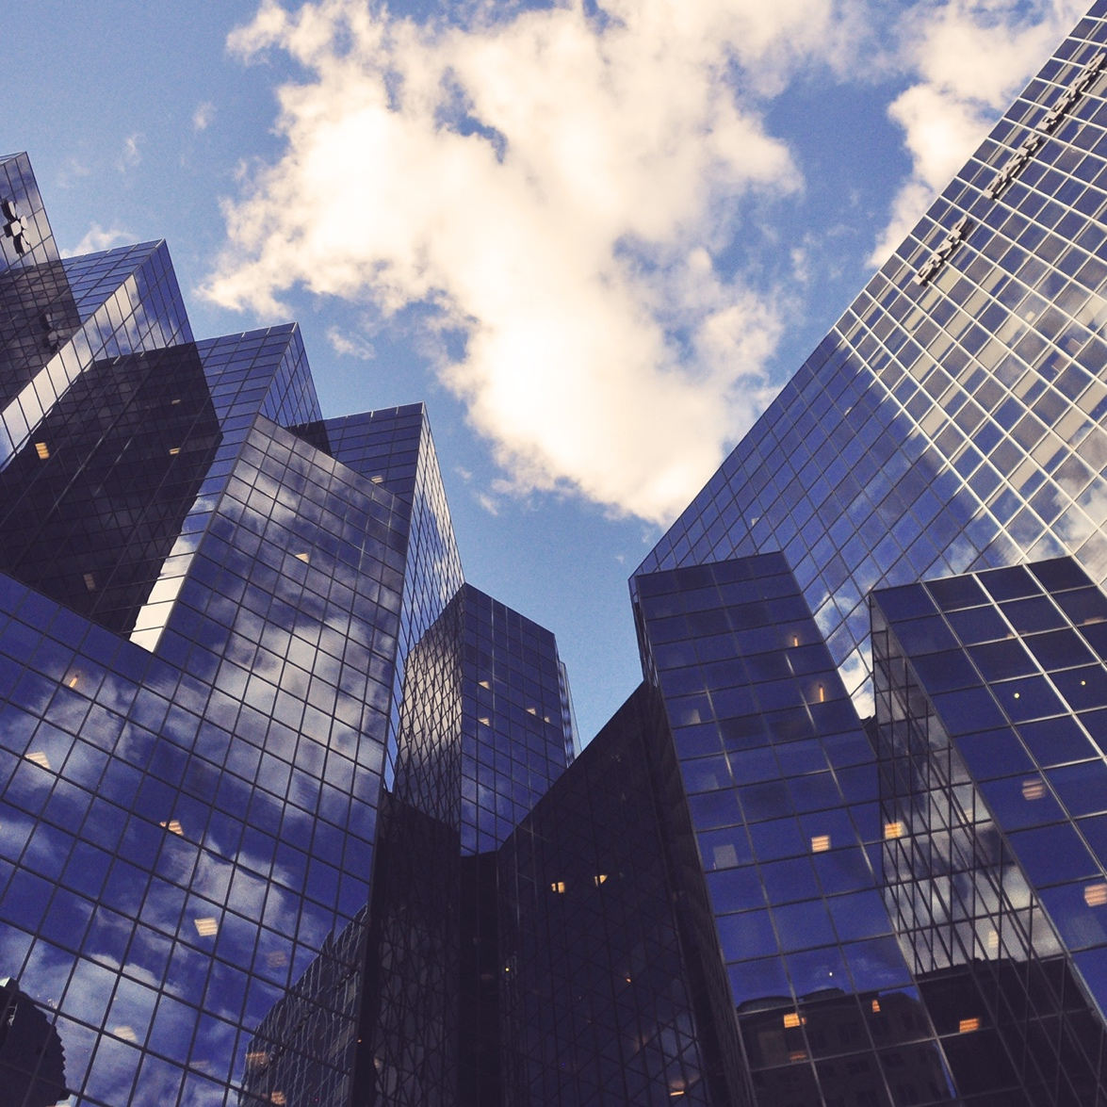
Easy Transportation: Smart cities have smart transportation systems that make it easier to get around. They reduce traffic congestion, improve public transportation, and provide real-time information to help us navigate the city more smoothly.
Economic Growth: Smart cities attract businesses and create job opportunities. They foster innovation, encourage entrepreneurship, and contribute to economic growth and development.
Environmentally Friendly: Smart cities focus on sustainability by using renewable energy sources, promoting energy-efficient buildings, and implementing eco-friendly practices. This helps protect the environment and combat climate change.

Slide 5
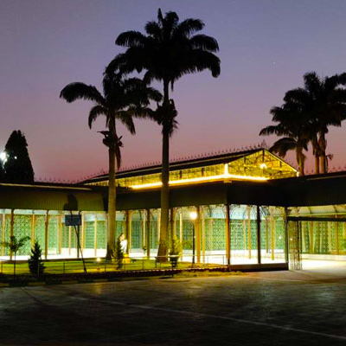
Efficient Governance: Smart cities use technology to improve governance processes. They streamline administrative tasks, make data-driven decisions, and provide better public services to residents.
Enhanced Safety and Security: Smart cities employ advanced technologies to enhance safety and security. They use surveillance systems, sensors, and predictive analytics to detect and respond to emergencies, keeping us safe.

Slide 6
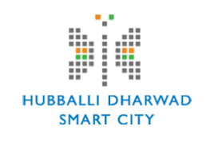
Hubli-Dharwad is a twin city located in the state of Karnataka, India. It is the second-largest city in Karnataka after Bangalore and forms a single municipal corporation known as the Hubli-Dharwad Municipal Corporation (HDMC). The city is a major commercial and industrial hub in the region.
Here are some key pieces of information about Hubli-Dharwad as a smart city:

Slide 7
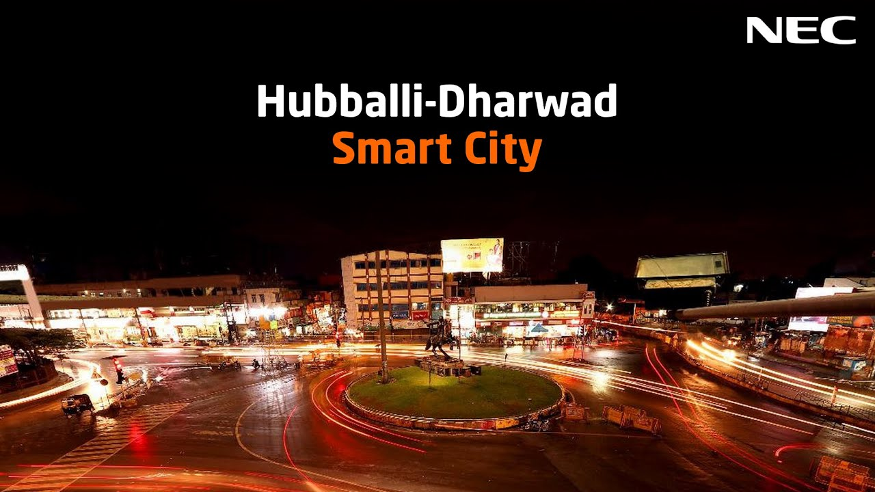
Key points of a smart city
☞ Smart City Initiative
☞ Area and Population
☞ Infrastructure Development
☞ Technology Integration
☞ Citizen Engagement
Green Initiatives
Economic Growth
☞ Education and Healthcare
☞ Tourism and Culture

Slide 8
Smart City Initiative
Hubli-Dharwad was selected under the Smart Cities Mission by the Government of India in the year 2016. The mission aims to promote sustainable and inclusive development in cities across the country.
Area and Population
The combined area of Hubli-Dharwad is approximately 200 square kilometers, and the estimated population is around 1.5 million people.

Slide 9
Infrastructure Development:
As part of the Smart Cities Mission, Hubli-Dharwad has been focusing on the development of various infrastructure projects. These include the improvement of road networks, transportation systems, water supply, sanitation, solid waste management, and urban housing.
Technology Integration:
The city has been working on integrating various technologies to enhance the quality of life for its residents. This includes the implementation of smart grids, intelligent transportation systems, e-governance platforms, and the use of information and communication technology (ICT) for better service delivery.

Slide 10
Citizen Engagement:
Hubli-Dharwad has been actively involving citizens in the decision-making process and encouraging their participation in the development of the city. The authorities have set up platforms for citizens to provide feedback, suggestions, and complaints, thus fostering a sense of ownership and transparency.
Green Initiatives:
The city has been promoting sustainable practices and green initiatives. This includes the development of green spaces, parks, and gardens, as well as the implementation of renewable energy projects and energy-efficient solutions.

Slide 11
Economic Growth:
Hubli-Dharwad has a diverse economic base, with industries such as engineering, manufacturing, textiles, agro-processing, and trade playing a significant role. The smart city initiatives aim to promote further economic growth and attract investments by providing a conducive business environment.
Education and Healthcare:
The city has a well-established education and healthcare sector. It is home to several educational institutions, including universities, colleges, and research centers. Hubli-Dharwad also has hospitals and medical facilities that cater to the healthcare needs of its residents.

Slide 12
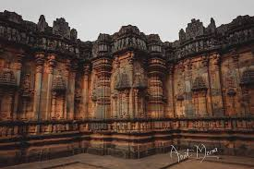
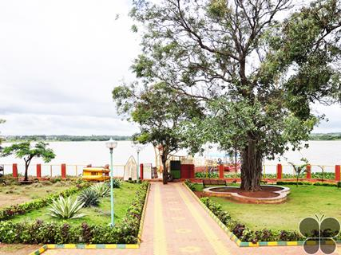
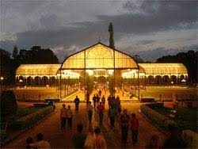
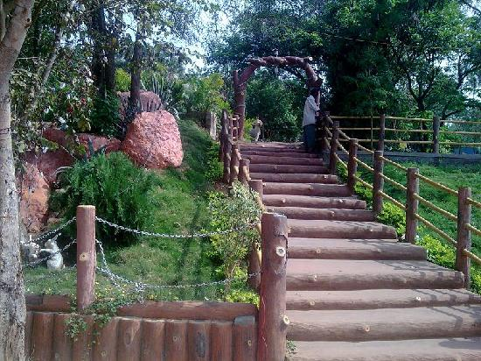
Tourism and Culture:
Hubli-Dharwad has a rich cultural heritage and is known for its historical and religious sites. The city attracts tourists with attractions like the Chandramouleshwara Temple, Nrupatunga Hill, Indira Gandhi Glass House Garden, and Unkal Lake.

Slide 13

video

Slide 14
Conclusions
The smart city initiative in Hubli-Dharwad is aimed at transforming the city into a sustainable, technologically advanced, and citizen-centric urban center. Through the implementation of various infrastructure projects, integration of technology, and citizen engagement, the city is working towards improving the quality of life for its residents and promoting economic growth

Slide 15
THANK You ☺

